Slide 1
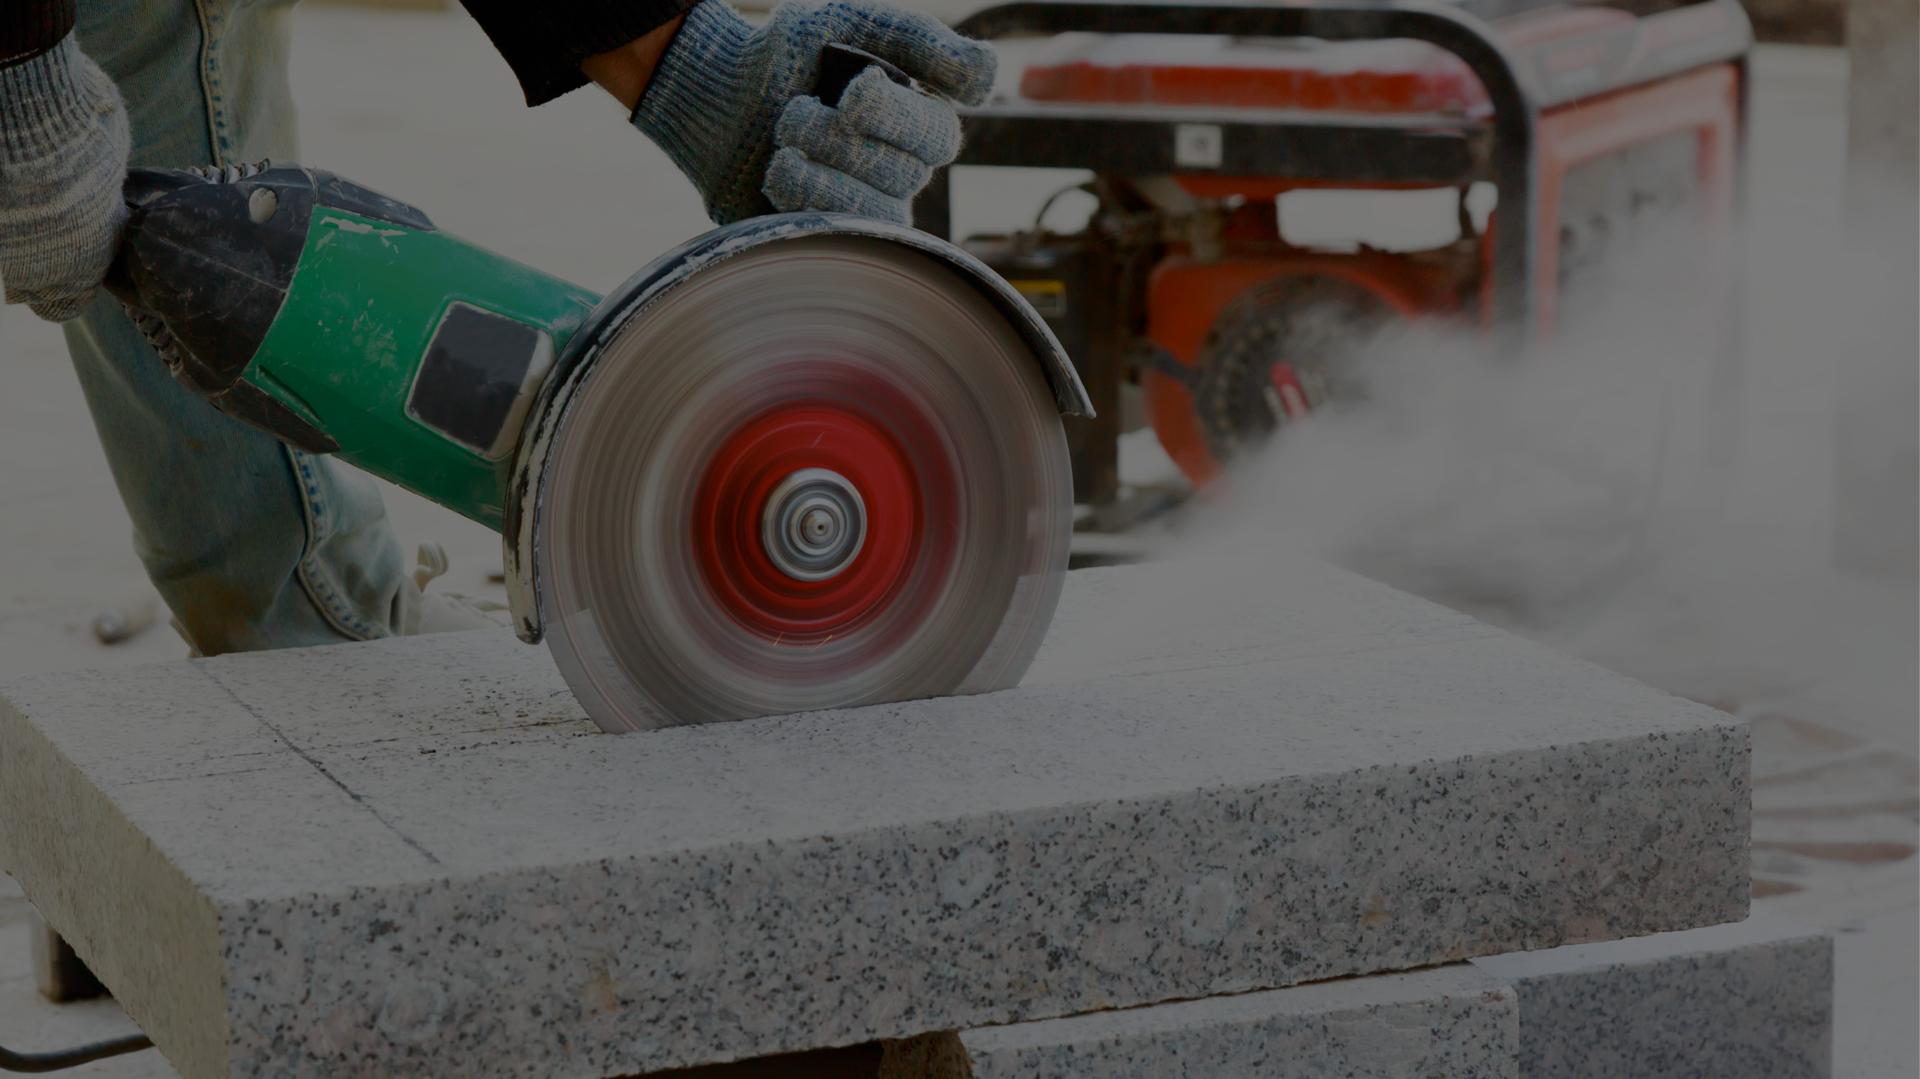
Engineered stone and silicosis
Kerry Cheung _{(MAIOH, MNZOHS,} _{HASANZ} _{Registered)}
Technical Specialist (Work Related Health)
Notes:
This presentation covers : MASTER
Explanation of what engineered stone is
The risks associated with working with it
The diseases workers are exposed to
What businesses and workers must do to avoid it
What WorkSafe and the health sector are doing together to help
The headline is that accelerated silicosis is showing itself to be a disease that targets our young workers

Slide 2
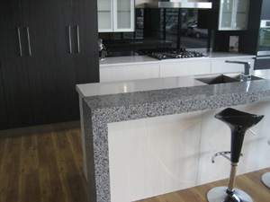
Engineered stone
Crystalline silica is not new.
Exposure to it occurs in:
quarrying, roading, foundries, concrete cutting and manufacture, monumental masonry, mining
increasingly, in kitchen and bathroom benchtop manufacturing and installation
Notes:
Engineered stone benchtops have become increasingly popular for kitchens and bathrooms.
Engineered stone is strong, attractive, resistant to cuts and stains
They are made by mixing finely crushed rock with a polymeric resin, then moulded into slabs and heat-cured.
The silica content of engineered stone is approximately 90% silica, which is much higher than natural stones.
Its silica content is a much higher percentage than the silica content of granite (30%) or marble (3%). (Leso 2019).

Slide 3
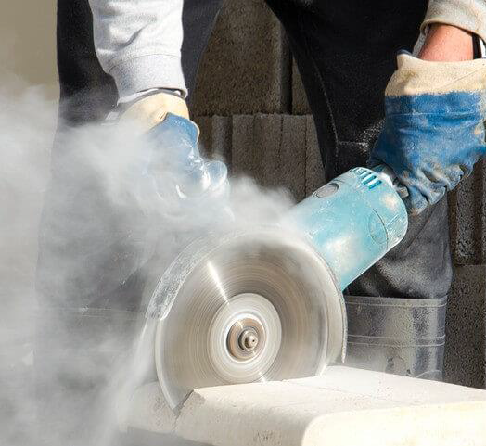
Benchtop manufacturing risks
Cutting, grinding, drilling, sanding and polishing
Using bridge saws, angle grinders, electric masonry drills, CNC machines
Installing sink and tap holes cut on site during installation
Notes:
Our strong advice to anyone involved in cutting, grinding or polishing engineered stone is to take all possible steps to avoid exposure to dust generated through these processes.
Workers may be exposed to RCS while cutting, grinding, sanding and polishing stone benchtops during manufacturing and installation.
Accelerated silicosis is one of three forms of silicosis that has been recently reported in workers working with engineered stone.
As with all risks, businesses working with engineered stone must be managing the risks in their workplace and ensuring effective controls are in place to protect workers.

Slide 4
Connor Downes
Connor is a 22-year-old stonemason from the Gold Coast, and the youngest Queenslander to be diagnosed with silicosis. He had only been working with engineered stone for 3 years.
Notes:
In May this year, WorkSafe issued a safety alert highlighting the serious health and safety risks of exposure to high levels of respirable crystalline silica (RCS) in the stone benchtop manufacturing industry.
This is because of the rapid rise in cases of accelerated silicosis in Australia.
Medical and health and safety professionals in New Zealand and Australia have been in close contact about the prevalence of the disease in Australia n benchtop manufacturing, with the intention of prevent ngi t occurring to the same extent in this country.

Slide 5
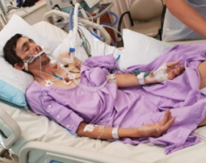
Anthony White
Was a 36-year-old stonemason from the Gold Coast was diagnosed with silicosis in 2017.
He died in March this year.
“
I want to make sure no one else has to go through this. It’s been absolutely horrendous for me and my family who have had to watch me get sicker and sicker.”
ANTHONY WHITE, 2018
Notes:
WorkSafe wants to raise awareness of this devastating disease before we get confirmed cases here.
Accelerated silicosis results from the inhalation of very high concentrations of silica dust.
It develops in a pattern similar to that of simple silicosis, except the time from initial exposure to the onset of disease is shorter and the progression to complicated silicosis is more rapid.
Specifically, nodules increase in size and merge into large lesions, leading to progressive massive fibrosis and ultimately cardio respiratory failure.

Slide 6
What diseases does RCS cause?
Silicosis
Acute silicosis: may occur after less than a year’s exposure to very large amounts
Accelerated silicosis: large amounts of RCS over 5 to 10 years
Chronic silicosis: moderate amounts over more that 20 years
NORMAL LUNG
LUNG WITH ADVANCED SILICOSIS
Notes:
RCS is also linked to
Lung cancer
Chronic obstructive pulmonary disease, a chronic lung condition which makes breathing difficult and may lead to emphysema, the main cause of which is long-term exposure to substances that irritate and damage the lungs
Kidney disease – some evidence that supports this

Slide 7
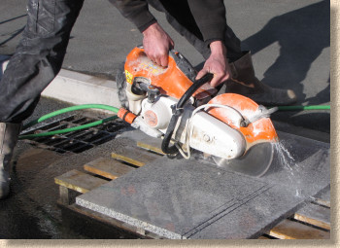
How to avoid silica exposure the hierarchy
Apply the hierarchy of controls
Elimination (don’t do it at all)
Substitution (do it some other way)
Engineering controls (make some physical change – see later)
Administrative controls (signage, limiting exposure time, adherence to methods)
Personal Protective Equipment
MOST EFFECTIVE
LEAST EFFECTIVE
Notes:
Elimination, substitution and engineering controls are the most effective controls to manage risks.
Administrative controls and use of personal protective equipment complement these.
Regarding respiratory protection, you must do the appropriate fit testing for it to offer any protection.

Slide 8
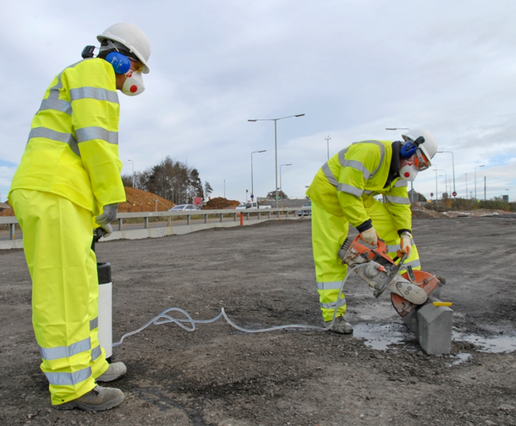
How to avoid silica exposure
Engineering controls
Water suppression
Dust extraction
Isolation of dusty work
Notes:
Health monitoring identifies changes to health status . WorkSafe is currently determining what is appropriate in light of the accelerated silicosis and we will advise once we have done that.
Exposure monitoring is also required to determine the amount of dust in the air so that appropriate RPE can be selected

Slide 9
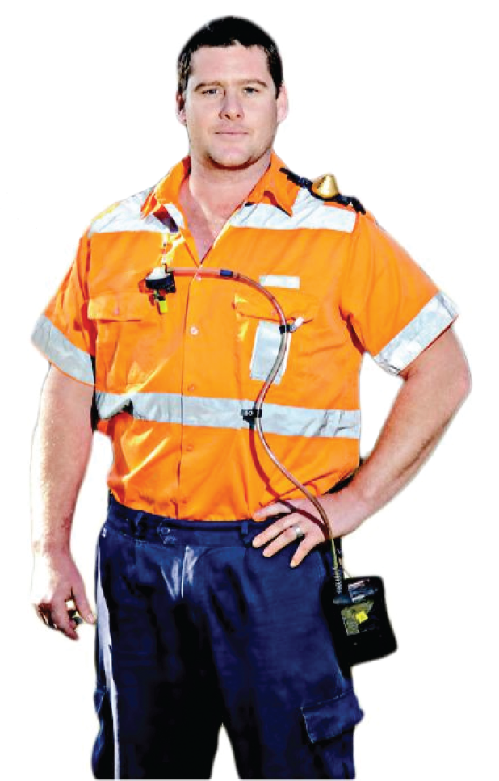
Exposure monitoring essential for managing risk
RCS particles are extremely small; they can’t always be seen with the naked eye and they are small enough to travel all the way to the bottom of the lungs
Exposure monitoring is the measurement and evaluation of exposure to a health hazard by an individual
Exposures are used to inform health risk assessment for the business (eg the need for and the type of respiratory protection, effectiveness of controls etc)
Notes:
The Worker Exposure Standard for quartz (the main component of RCS) is the amount of airborne dust that according to current knowledge, is UNLIKELY to lead to health issues for MOST people over a working life.
The current WorkSafe exposure standard of 0.1 milligrams per cubic metre.
WorkSafe is proposing a new WES of half of that value.
Exposure monitoring usually involves an Occupational Hygienist attaching a pump to a worker and collecting a PERSONAL dust sample over, usually, an entire shift, from the breathing zone
Sufficient samples MUST be taken to reliably determine exposure
It must be carried out by a competent person .
That means the person doing the exposure monitoring must be:
registered on the HASANZ Register for occupational hygiene; or
a full membership of New Zealand Occupational Hygiene Society.

Slide 10
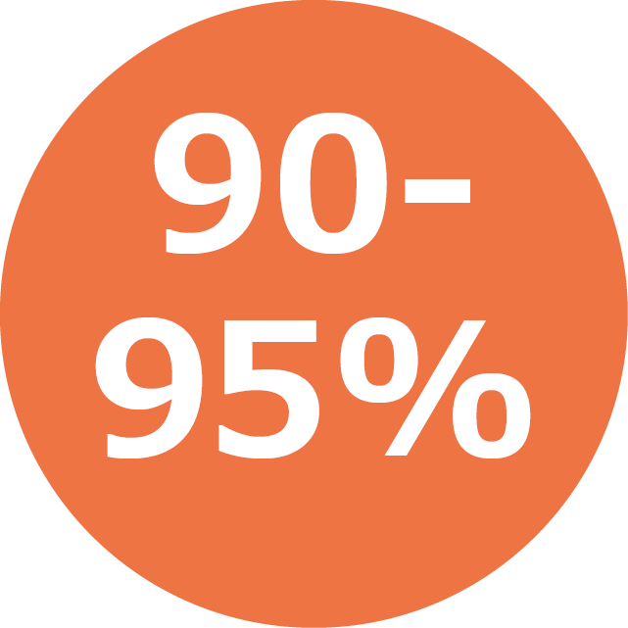
Accelerated silicosis – the numbers
Confirmed cases of silicosis in Queensland as of July 2019
Percent silica in engineered stone compared with 30% in granite
Years it usually takes for accelerated silicosis to develop versus 10-30 years for chronic silicosis
Notes:
As of July 2019, the number of confirmed cases of silicosis in Queensland reached 153.
Accelerated silicosis differs from chronic silicosis in that it takes 1-10 years to develop versus 10-30 years (AIOH, 2018).
Accelerated silicosis is characterised by a short latency period, extensive pulmonary damage, and its presence in young workers (Leso 2019).
The greater aggressiveness of accelerated silicosis is usually attributed to a lack of adequate preventive or protective measures.

Slide 11
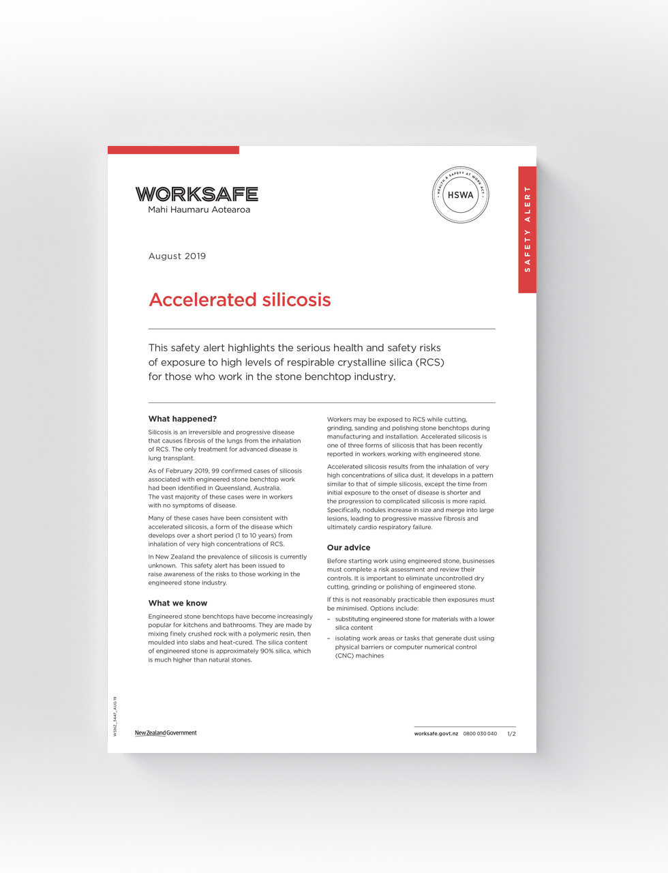
What is WorkSafe doing about it?
New guidance:
Accelerated silicosis safety alert
8 key things for workers to know
Notes:
We are working rapidly, in partnership with the health sector, to understand this emerging issue, the risk in New Zealand, and the priority actions.
WorkSafe has commenced targeted assessment visits of workplaces that work with engineered stone benchtops.
The focus of the visits is to ensure businesses are aware of the risks and have adequate protection for their workers, and to identify any necessary remedial actions they are required to make.
Information will also be gathered to help inform us of the extent and likely exposure to accelerated silicosis in New Zealand and to help answer any enquires. We estimate visits will be completed by the end of the year.
SELF-REFERRAL PROCESS IN DEVELOPMENT (from letter to people who had provided contact details for info: WorkSafe also continues to work with the Ministry of Health and ACC to set up a self-referral process for workers who consider themselves at high risk of exposure to dust from engineered stone.)
We encourage anyone with concerns about accelerated silicosis to visit our website and record their details so we can keep in touch with them as more information becomes available.

Slide 12
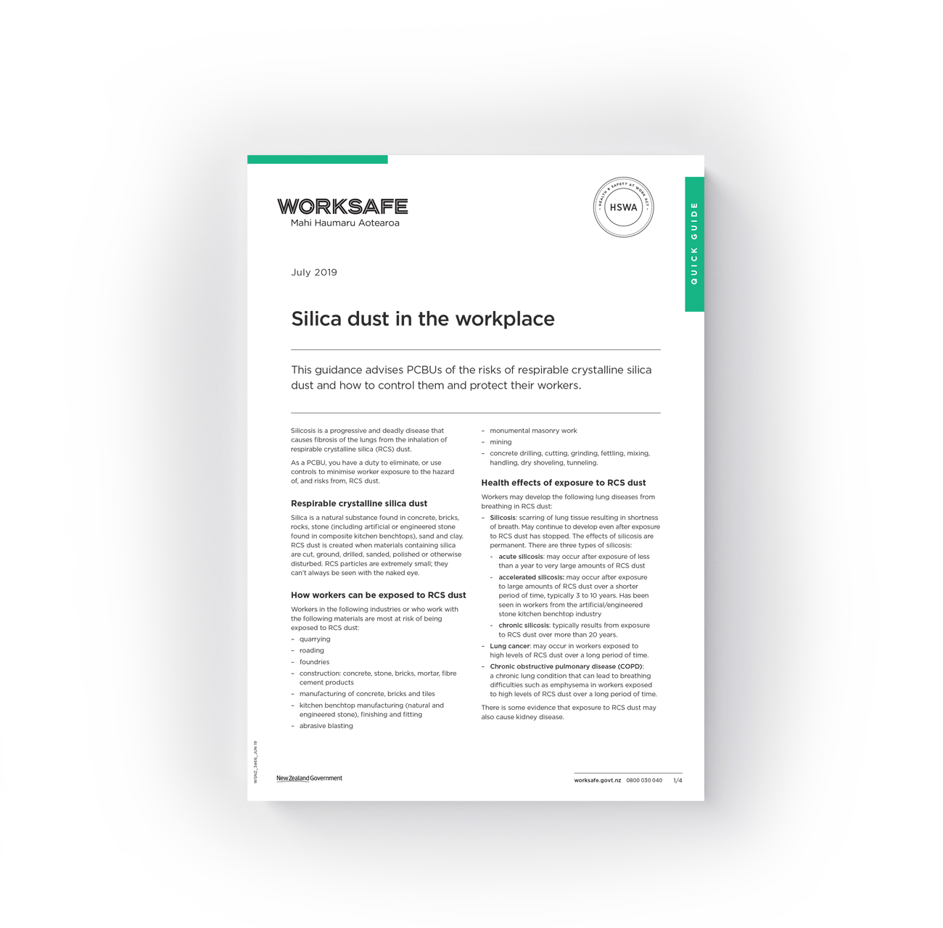
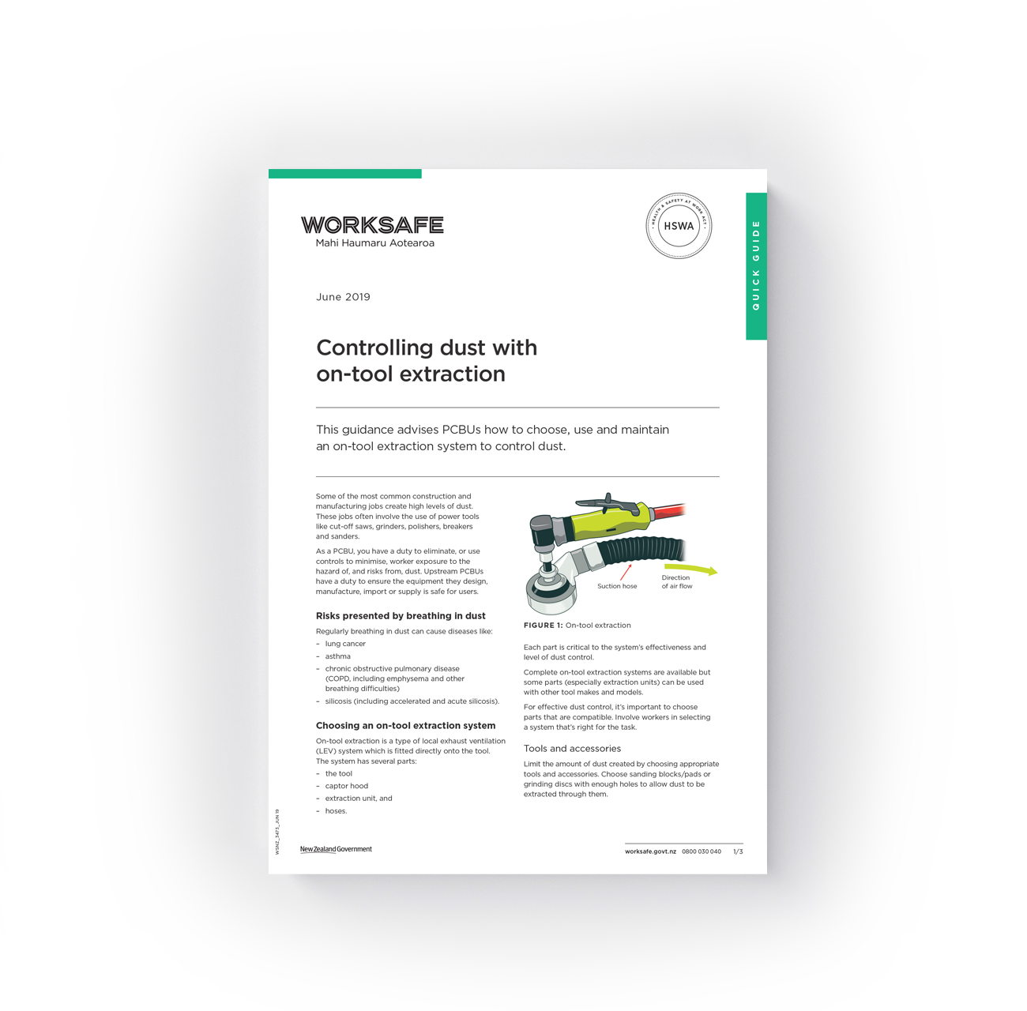
What is WorkSafe doing about it?
Modified existing quick guides:
Silica dust in the workplace
Controlling dust with on-tool extraction (replaces controlling construction dust with on-tool extraction)
Notes:
We are working rapidly, in partnership with the health sector, to understand this emerging issue, the risk in New Zealand, and the priority actions.
WorkSafe has commenced targeted assessment visits of workplaces that work with engineered stone benchtops.
The focus of the visits is to ensure businesses are aware of the risks and have adequate protection for their workers, and to identify any necessary remedial actions they are required to make.
Information will also be gathered to help inform us of the extent and likely exposure to accelerated silicosis in New Zealand and to help answer any enquires. We estimate visits will be completed by the end of the year.
SELF-REFERRAL PROCESS IN DEVELOPMENT (from letter to people who had provided contact details for info: WorkSafe also continues to work with the Ministry of Health and ACC to set up a self-referral process for workers who consider themselves at high risk of exposure to dust from engineered stone.)
We encourage anyone with concerns about accelerated silicosis to visit our website and record their details so we can keep in touch with them as more information becomes available.

Slide 13
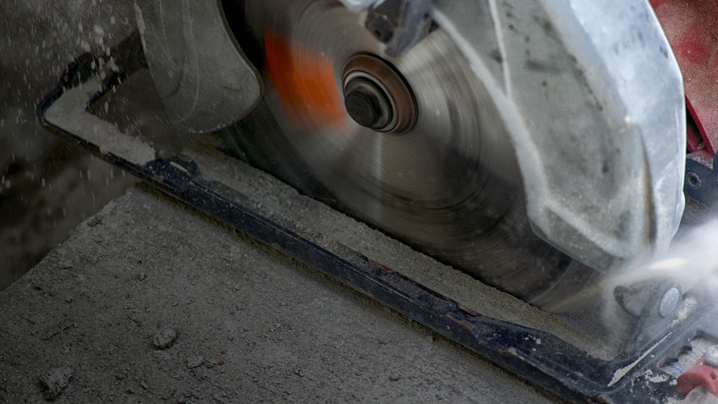
“
Health and safety is about harnessing the power of the whole team.”
LAWRENCE WATERMAN, 2013
Notes:
It’s worth noting that WorkSafe’s inspectors have been trained on airborne contaminants and supporting workplaces to control these risks since 2016.
This is when its first work-related health intervention to raise awareness of the health risks of respirable crystalline silica dust, organic solvents, welding fumes, wood dust, carbon monoxide and agrichemicals commenced.

Slide 14
WorkSafe resources
Webpage for concerned parties to indicate their interest – accessible on homepage: worksafe.govt.nz
Search WorkSafe website worksafe.govt.nz for:
Accelerated silicosis SAFETY ALERT
Controlling dust with on-tool extraction QUICK GUIDE
Silica dust in the workplace QUICK GUIDE
8-key things for workers to know – Controlling silica dust in the workplace
Accelerated Silicosis FACT SHEET
Notes:
Questions to answer / concerns to pass on

